Slide 1
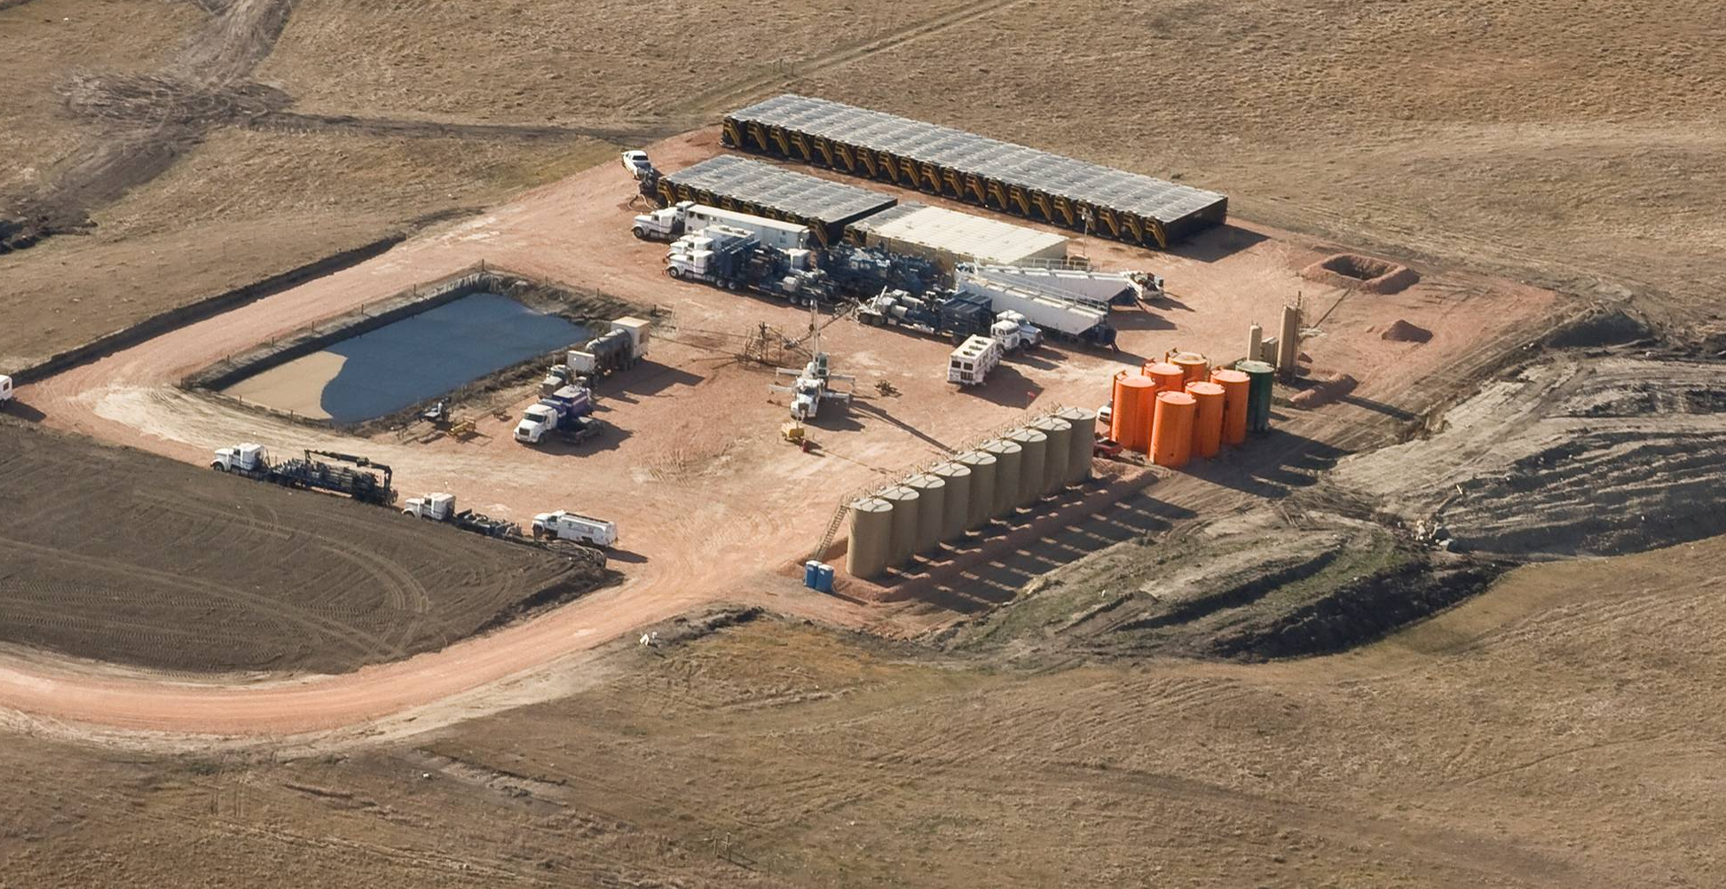
Bakken Water Opportunities Assessment
Bethany Kurz
Energy & Environmental Research Center

Slide 2
Bakken Water Opportunities: Phase I
Project to assess the technical and economic potential to recycle frac flowback water in the Bakken play.
Project sponsors
North Dakota Industrial Commission Oil and Gas Research Council
U.S. Department of Energy
North Dakota Petroleum Council

Slide 3
Frac Flowback Water Characteristics
Five different companies provided data from a total of 89 wells.
Relatively low recovery of the original frac water within the first 10 days.
Ranges from 15% to 50% recovery
Very high salinity in flowback water.
Salinity levels as high as 220,000 mg/L
Predominantly NaCl, with lesser amounts of calcium, potassium, and sulfate

Slide 4
Phase I Conclusions
Treatment very challenging, even with the most robust technologies.
Treatment very likely not cost-effective in most cases.
However, multi-well pads (“Eco-Pads”) may help overcome recovery issues, and treatment technologies continue to improve.

Slide 5
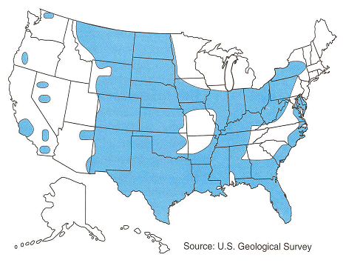
Phase II Project Goals
To assess the technical and economic feasibility of brackish groundwater treatment for use in western North Dakota’s oil industry.
General location and extent of saline groundwater resources in the United States (Source: Mike Hightower, Sandia National Laboratories).

Slide 6
Project Status
The EERC is partnering with a major oil producer in the state to conduct a pilot project using reverse osmosis (RO) to treat brackish groundwater.
Site location is near Tioga, North Dakota
Existing water production well.
Excellent pumping capacity.

Slide 7
Groundwater Properties
Dakota Aquifer (lower Cretaceous)
Water temperature: ~150ºF
Well screen depth: 5500 feet
Total dissolved solids (TDS): ~9000–11,000 mg/L.
Water Classification | TDS Concentration, mg/L
Fresh | <1000
Slightly Saline | 1000 – 3000
Moderately Saline | 3000 – 10,000
Saline | 10,000 – 35,000
Seawater | >35,000

Slide 8
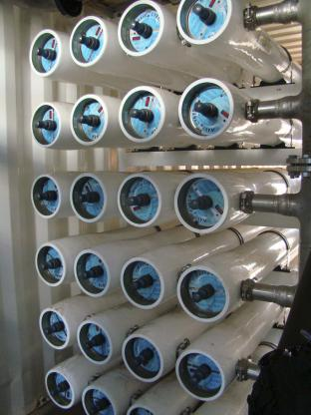
RO Treatment System
Mobile RO system provided by GE Water & Process Technologies.
Trailer-mounted system.
Includes two RO treatment trains each capable of producing 80 gpm of clean water (permeate).

Slide 9
Cooling System
Water must be cooled to less than 100ºF before entering the RO membranes.
The EERC suggested that heat exchangers be used as part of the system to capitalize on the waste heat of the feedwater.
GE provided tube-and-shell heat exchangers coupled with an air-cooled system (with foggers).

Slide 10
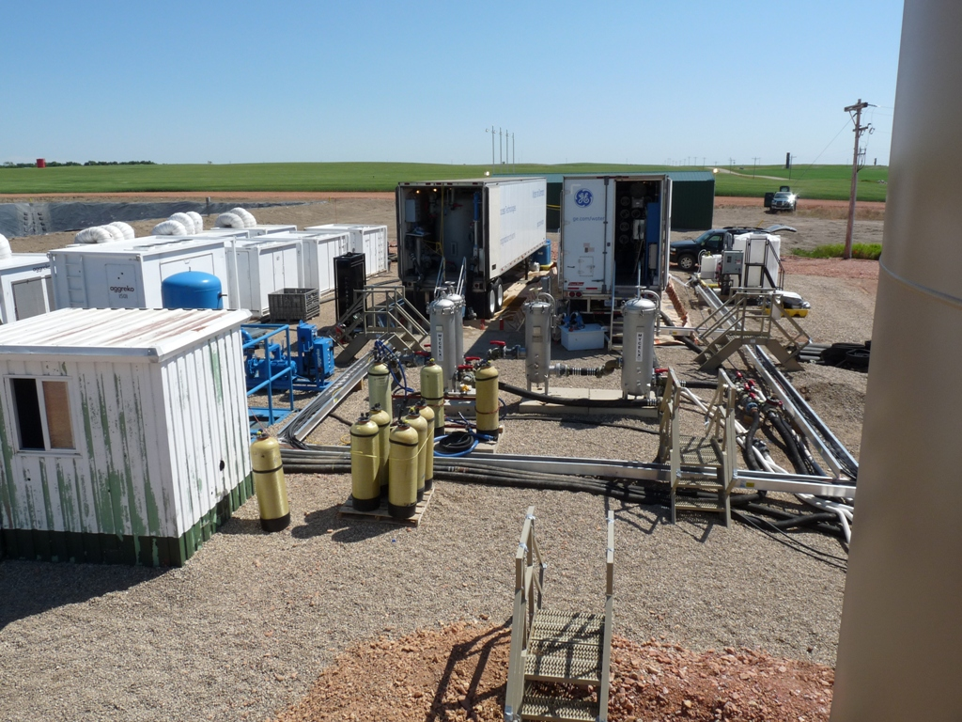

Slide 11
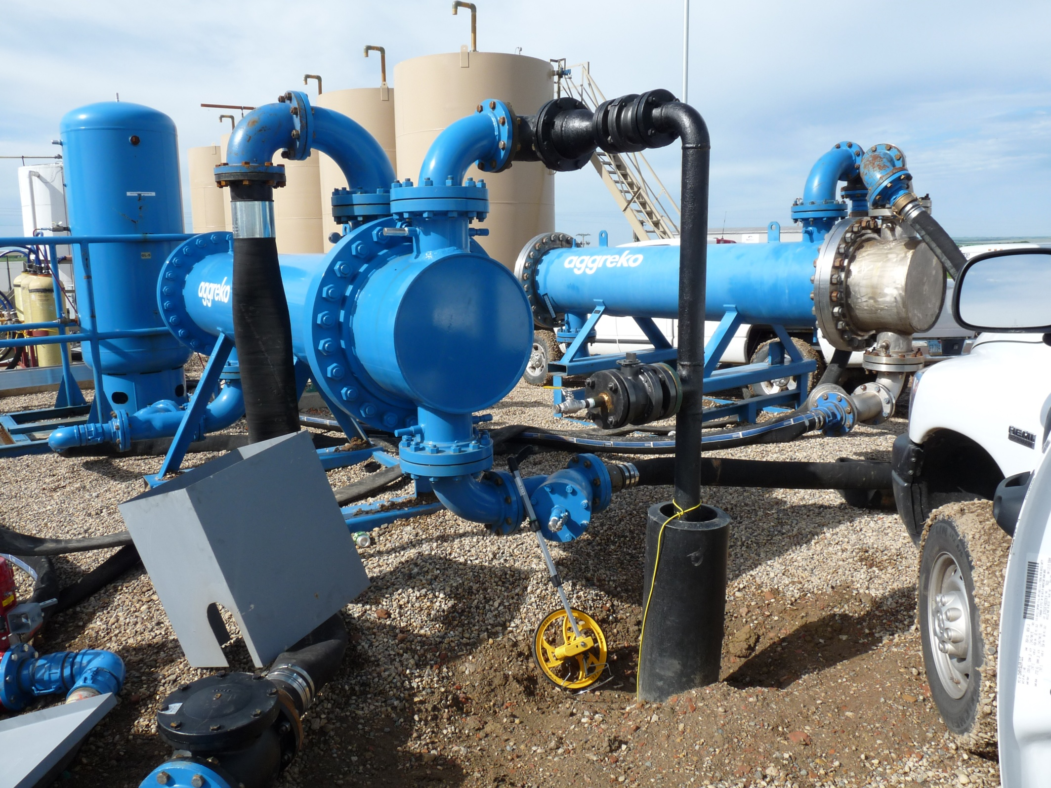

Slide 12
Corrosion Testing
The EERC is evaluating the corrosivity of the feedwater, permeate, and concentrate.
Corrosion test racks containing various metal and metal alloy coupons were installed at the site.

Slide 13
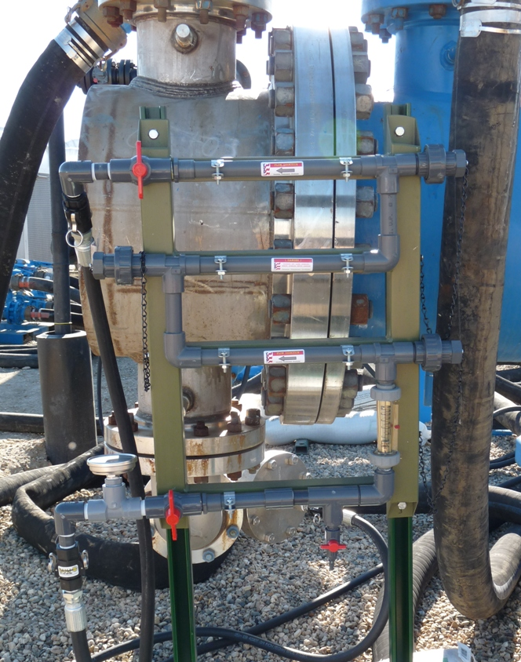

Slide 15
System Performance
The RO system has been running intermittently since July 23.
~ 70% recovery
Permeate production rate: 80 – 160 gpm (115,200 – 230,400 gallons per day)
Treated water is stored in a lined and covered pond.
An on-site hauling station allows 4 trucks to fill in 20 minutes.

Slide 16
Next Steps
Continue to monitor the system and evaluate its performance, especially at steady-state conditions.
Summarize existing corrosion test results, and conduct additional testing.
Evaluate the economic feasibility of this approach as a water supply source for the oil industry and for other applications.

Slide 17
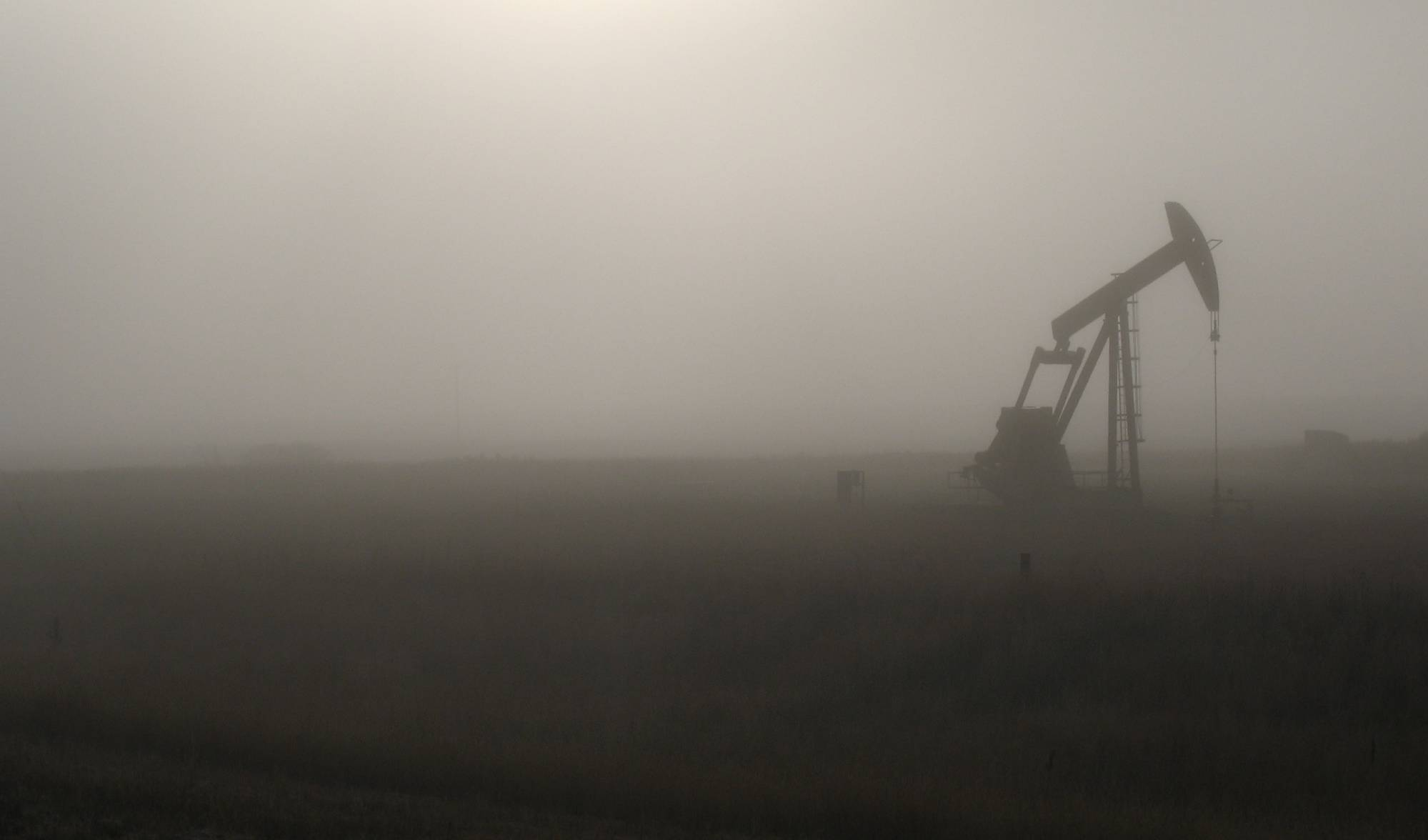
Contact Info
Bethany Kurz
Senior Research Manager
(701)777-5050
bkurz@undeerc.org
Energy & Environmental Research Center
University of North Dakota
15 North 23rd Street, Stop 9018
Grand Forks, North Dakota 58202-9018
World Wide Web: www.undeerc.org

